Slide 1
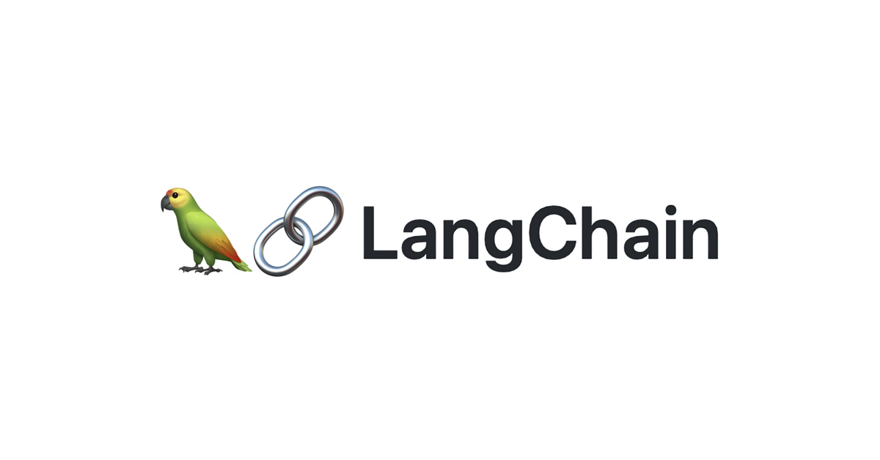
RAG from scratch: Routing
(Logical + Semantic)
Lance Martin
Software Engineer, LangChain
@RLanceMartin

Slide 2
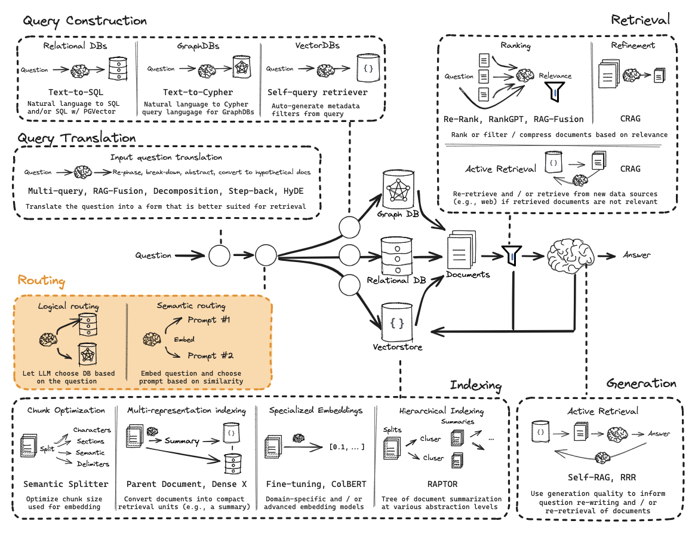
Query Translation

Slide 3
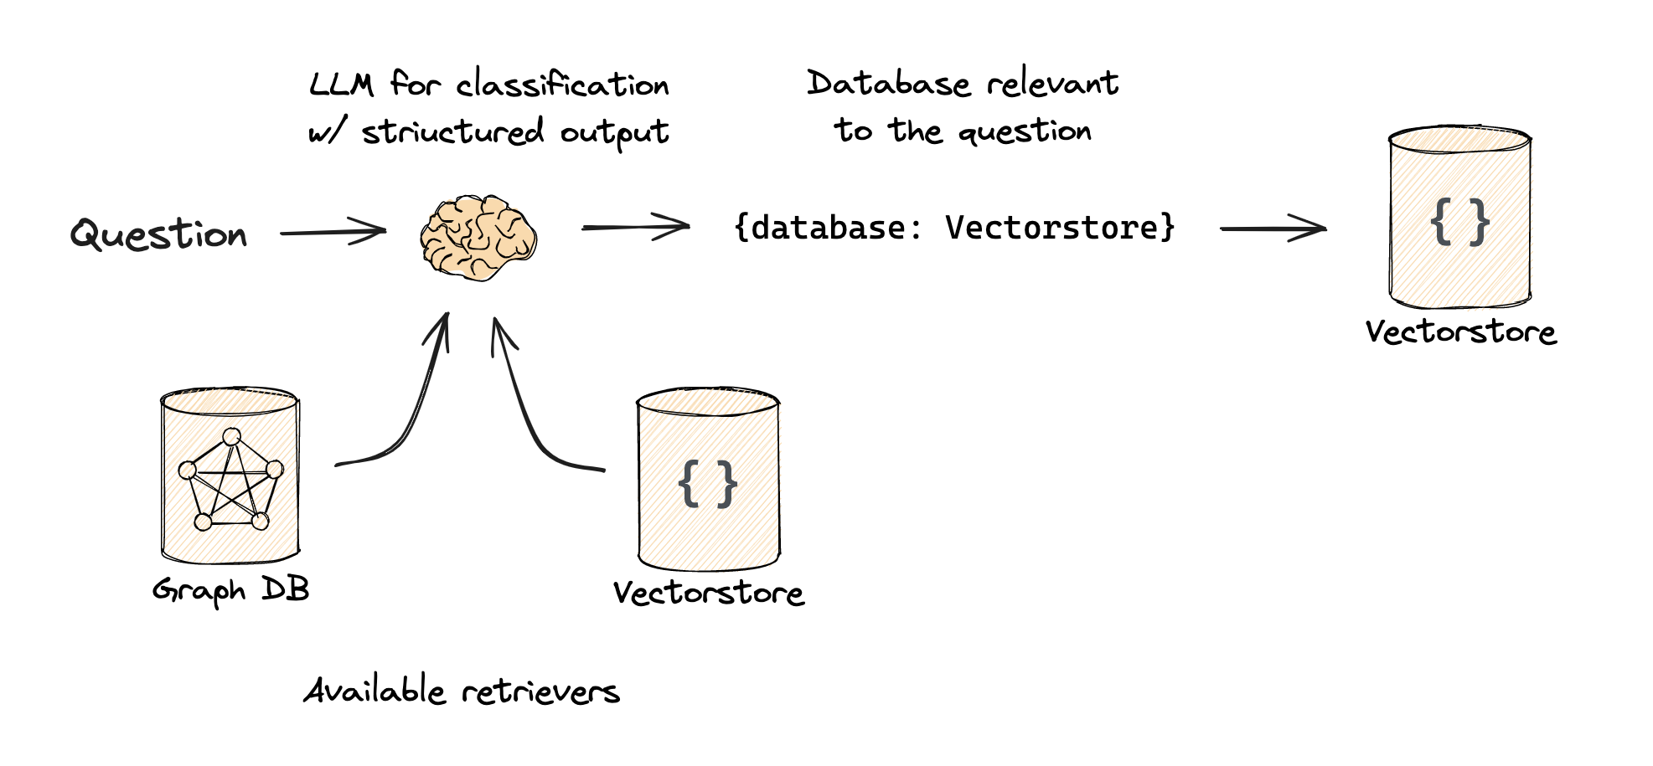
Logical routing
https://python.langchain.com/docs/use_cases/query_analysis/techniques/routing

Slide 4
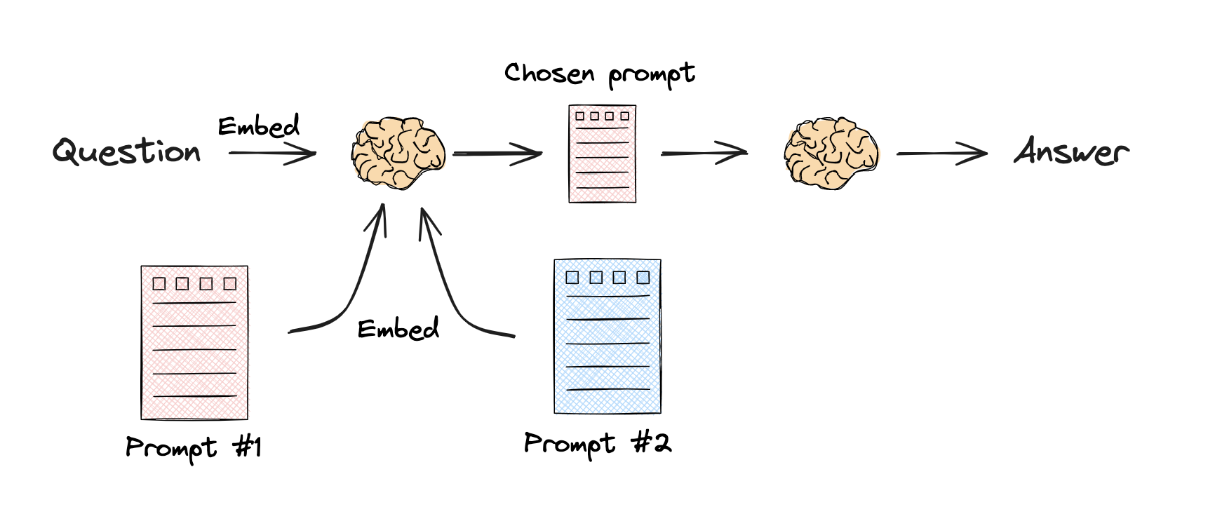
Semantic routing
https://python.langchain.com/docs/expression_language/cookbook/embedding_router

Slide 5
Code walk-through

